Slide 1
Thermoregulation and regulation of body fluids

Slide 2
What are we doing today?
Thermoregulation occurs by the control of heat exchange and metabolic activity through physiological and behavioural mechanisms (SU)
Body fluid concentrations are maintained by balancing water and salts via the skin, digestive system and the kidneys, which involve the actions of antidiuretic hormone (ADH) and aldosterone on the nephron, and the thirst reflex (SU)
Feedback systems – positive and negative (SU)
Homeostatic processes involve nerves and hormones in maintaining the body’s internal environment within tolerance limits through the control of metabolism and physiological and behavioural activities (SU)
Select, use and/or construct appropriate representations, including diagrams, models and flow charts, to communicate conceptual understanding, solve problems and make predictions.(SIS)

Slide 3
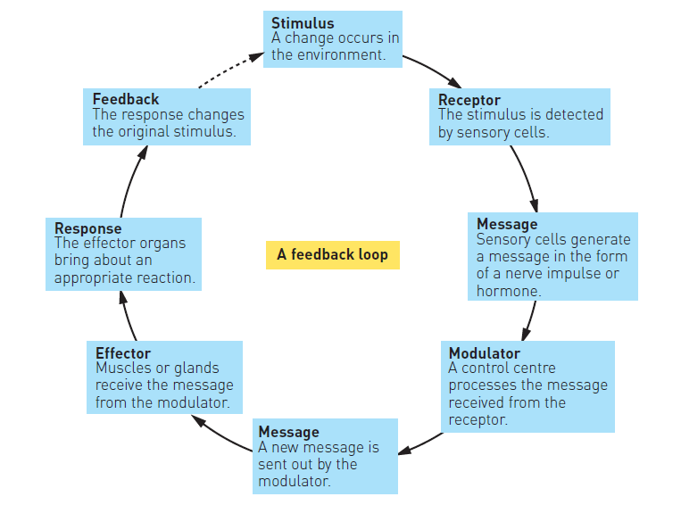
Negative feedback
Response reduces or eliminates the stimulus that causes it

Slide 4

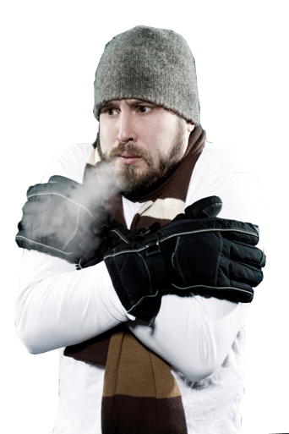
Thermoregulation
Body temperature is regulated by the hypothalamus. In humans, the hypothalamus has a “set point” of 36.7ºC.
The hypothalamus responds to core temperature changes and nerve impulses from receptors in the skin.
It coordinates appropriate nervous and hormonal responses to return the body to its normal temperature.

Slide 5


Counteracting Heat Loss
Heat promoting center in the hypothalamus monitors fall in temperature below 35.8ºC and promotes responses that conserve heat.
Factors affecting heat loss:
Any factor that increases the thermal gradient will accelerate heat loss through radiation:
Wind (wind chill factor)
Cold external temperatures
Being inadequately clothed
Being wet or in cold water accelerates conductive heat loss.
Dehydration and circulatory shock accelerate heat loss because a lower blood volume reduces capacity to retain heat.
Responses to heat loss are brought about primarily through the sympathetic nerves of the autonomic nervous system.
Thyroxine and epinephrine increase metabolic rate.
In extreme cold thyroxine and epinephrine increase energy-releasing activities in the liver.
Muscle activity produces internal heat.
Erector muscles of hairs contract to raise hairs and increase the insulating layer of air. Blood flow to skin decreases.

Slide 6
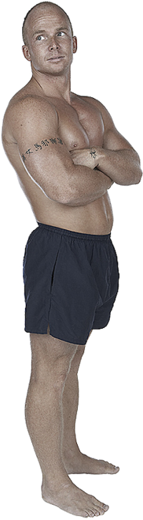
Counteracting Heat Gain
Heat losing centre in the hypothalamus monitors any rise in temperature above 37.5ºC and coordinates responses that increase heat loss.
Factors causing heat gain include:
Gain of heat through a warmer environment.
High humidity reduces effectiveness of evaporative cooling.
Excessive fat deposits make it harder to lose heat generated by activity.
Heavy clothing that traps air and doesn’t allow heat to escape.
Responses to heat gain are brought about primarily through the parasympathetic nerves of the autonomic nervous system.
Sweating increases cooling by evaporation.
Muscle tone and metabolic rate are decreased, reducing heat output.
Blood flow to skin increases.
Erector muscles of the hairs relax, flattening hair and reducing the insulating air layer.

Slide 7
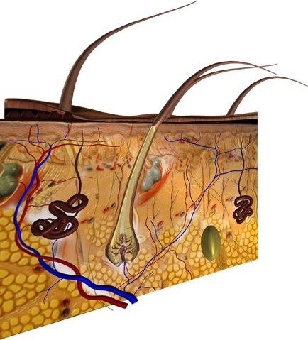
The Skin and Thermoregulation
Hairs raised or lowered to increase or decrease the thickness of the insulating air layer.
Thermoreceptors in the dermis detect changes in skin temperature outside the normal range and send nerve impulses to the hypothalamus.
Thermoreceptors come in two types:
Hot thermoreceptors detect a rise above 37.5ºC
Cold thermoreceptors detect a drop below 35.8ºC.
The regulation of temperature by the skin forms a negative feedback loop.
Sweat glands produce sweat in response to parasympathetic stimulation from the hypothalamus. Sweat cools through evaporation.
Fat in the subdermal layers insulates the organs against heat loss.
Blood vessels in the dermis
- dilate to promote heat loss
- constrict to reduce heat loss

Slide 8
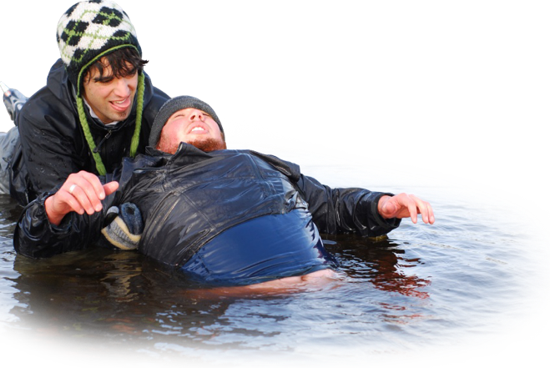
Hypothermia
Hypothermia is a condition caused when the body’s core temperature drops below 35ºC.
The condition ranges from mild to severe depending how low the body temperature has dropped.
Severe hypothermia results in mental confusion, including inability to speak and amnesia, organ failure, and death.

Slide 9
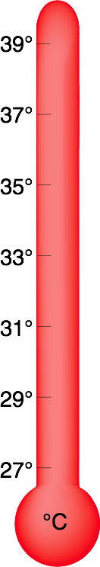
Departures from Normal
Hyperthermia: Body temperatures above normal cause metabolic problems that can lead to death.
Mild hypothermia: Shivering. Vasoconstriction reduces blood flow to the extremities. Hypertension and cold diuresis (increased urine production due to the cold).
Moderate hypothermia: Muscle coordination becomes difficult. Movements slow or labored. Blood vessels in ears, nose, fingers, and toes constrict further resulting in these turning a blue color. Mental confusion sets in. In some cases, victim may shed clothing (paradoxical undressing).
Severe hypothermia: Speech fails. Mental processes become irrational, victim may enter a stupor. In some cases, the brain stem produces hide and die behavior. Organs eventually fail and death follows.
Normal body temperature

Slide 10
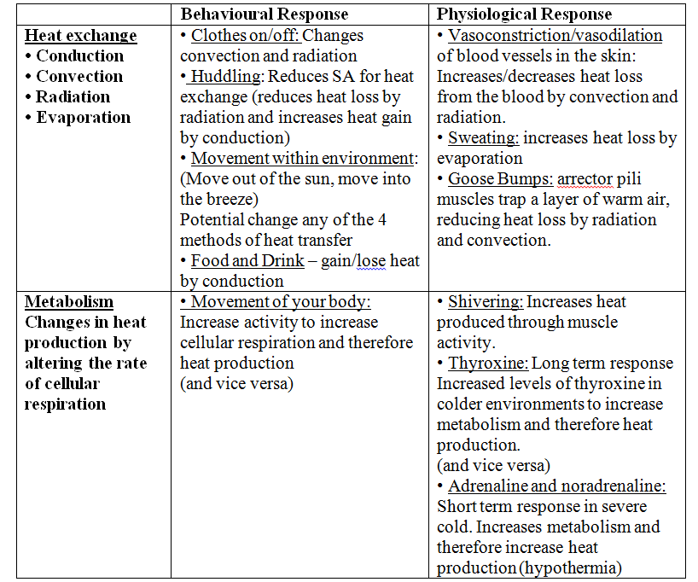

Slide 11
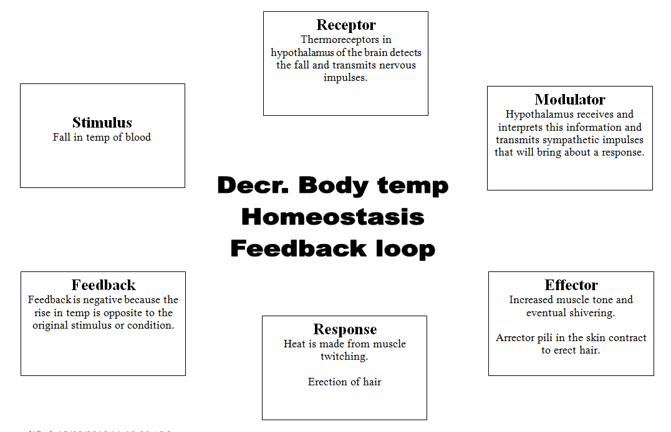
Thermoregulation

Slide 12
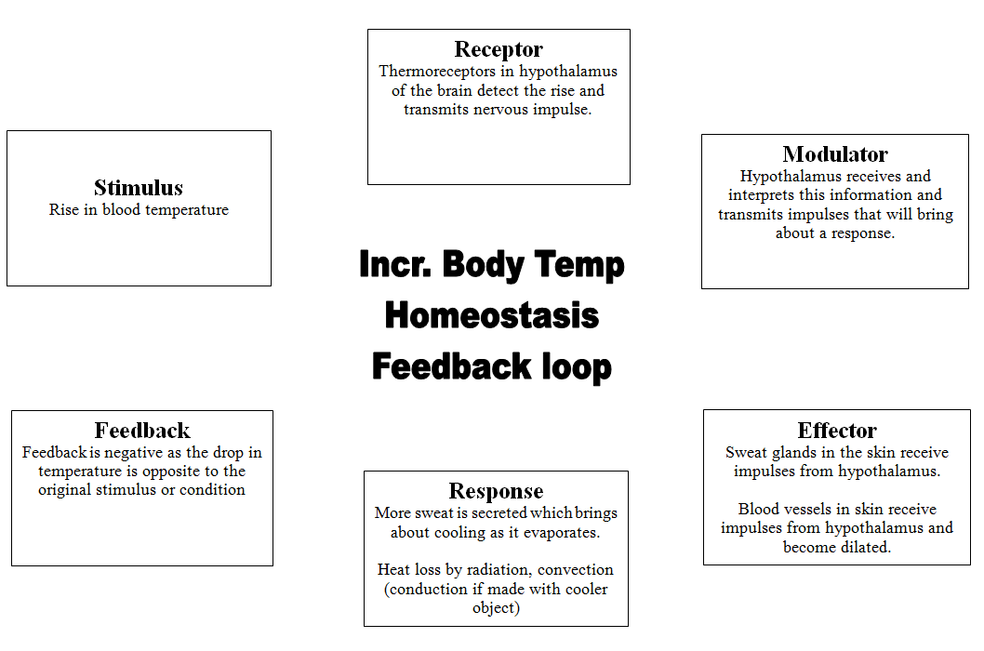
Thermoregulation

Slide 13
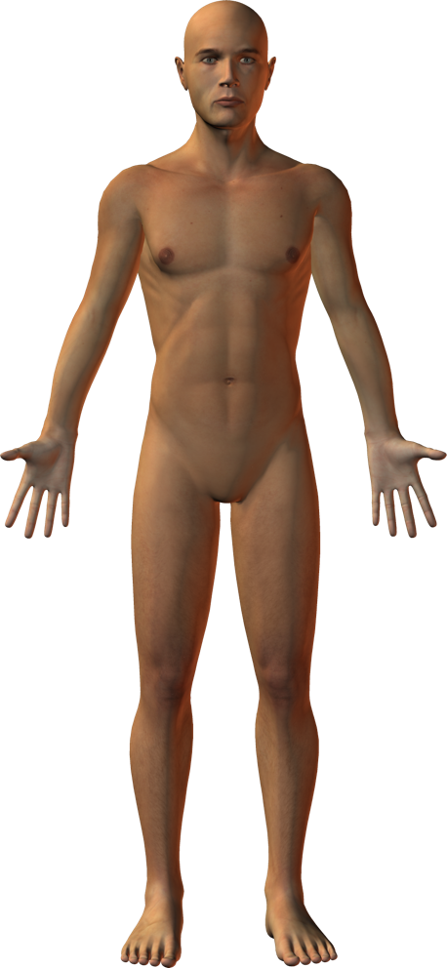
Fluid Balance
The body's fluid and electrolyte balance is critical to metabolic function.
Water makes up around 60% of the body and is found within two main fluid compartments.
The intracellular fluid makes up 60-66% of the water in the body and is found within the body's cells.
The extracellular fluid makes up the rest of the body's water and can be divided into intravascular fluid (mostly blood) and the extravascular fluid (interstitial fluid around the cells).
40 %
solids
66%
intracellular fluid
60%
fluids
33%
extracellular fluid
80%
interstitial
fluid
20% plasma
Fluids and solids in an average person

Slide 14
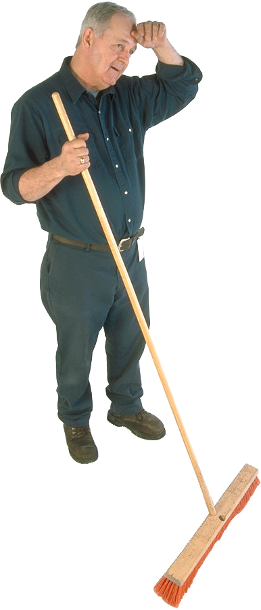
Maintaining Fluid Balance
Loss of water and ions through sweat.
Fluid and electrolyte balance in the body are maintained by the kidneys (with some help from the skin).
The kidneys regulate the reabsorption of water and sodium from the blood in response to regulatory hormones.
Osmoreceptors monitor blood volume and bring about the release of these hormones.
Water loss through breathing.
Water and ions taken in with food and drink.
Loss of water and ions through urine and feces.

Slide 15
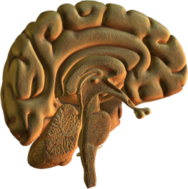
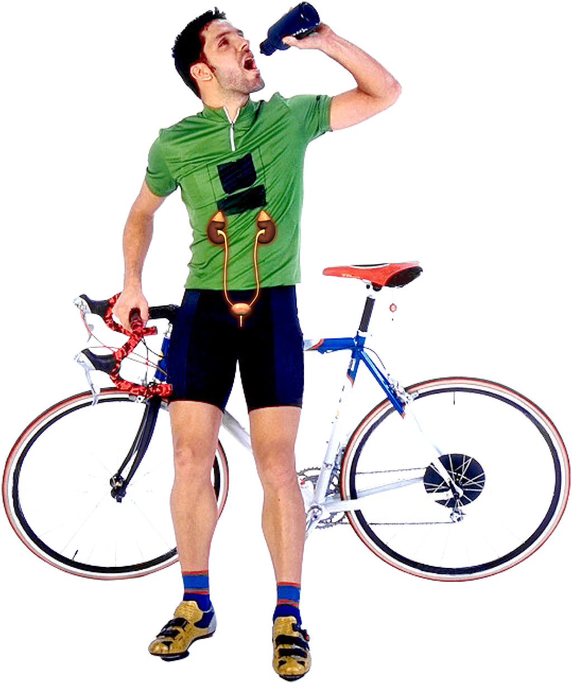
Control of Urine Output
Variations in salt and water intake, and in the environmental conditions to which we are exposed, contribute to fluctuations in blood volume and composition.
The primary role of the kidneys is to regulate blood volume and composition (including the removal of nitrogenous wastes), so that homeostasis is maintained.
This is achieved through varying the volume and composition of the urine. Two hormones, antidiuretic hormone (ADH) and aldosterone, are involved in the process.
Aldosterone produced by the adrenal cortex
ADH released from the posterior pituitary
Hemera

Slide 16
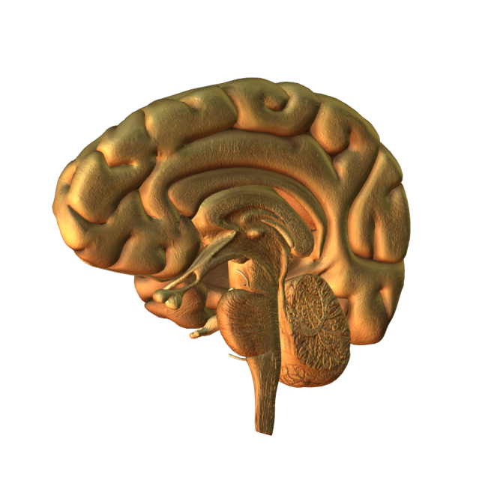
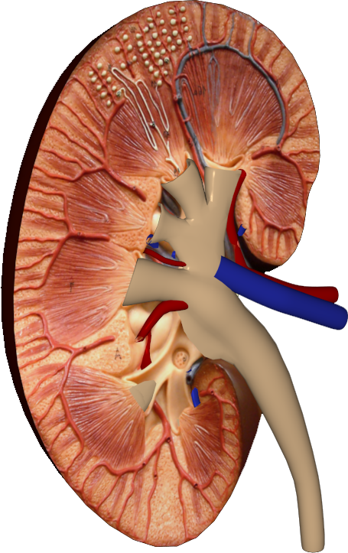
Aldosterone and ADH
Osmoreceptors in the hypothalamus detect a fall in the plasma volume.
They stimulate neurosecretory cells in the hypothalamus to synthesize and secrete the hormone ADH (antidiuretic hormone).
ADH passes from the hypothalamus to the posterior pituitary where it is released into the blood.
ADH increases the permeability of the kidney collecting duct to water so that more water is reabsorbed and urine volume decreases.
Aldosterone acts on the distal tubules and collecting ducts of the nephron, causing conservation of sodium ions and secretion of potassium ions.
ADH
Aldosterone

Slide 17
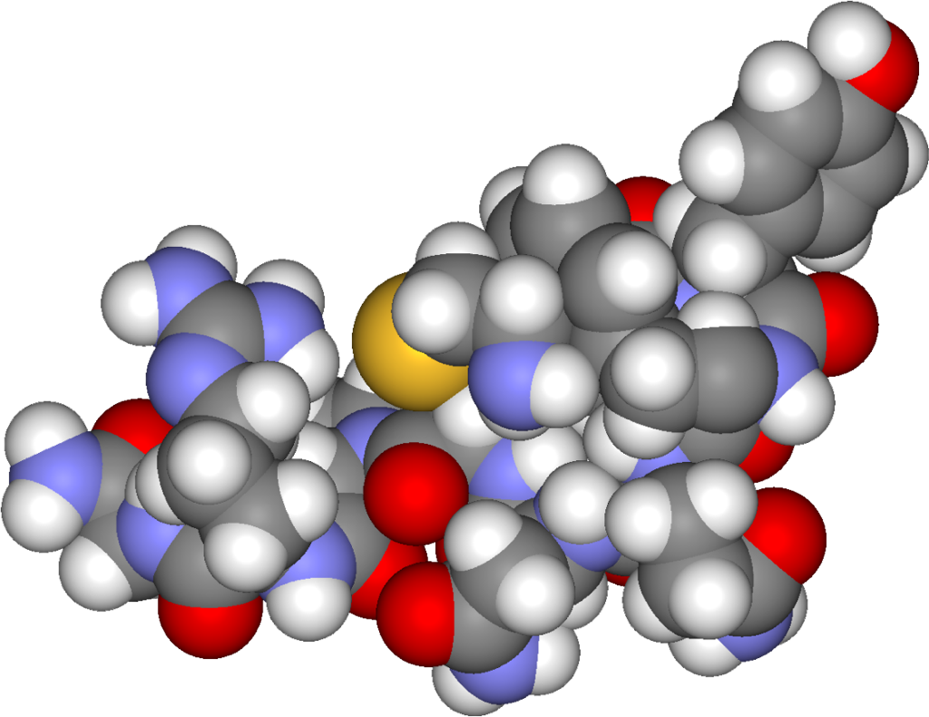
Release and Inhibition
Factors inhibiting ADH release
• Low solute concentration• High blood volume
• Low blood sodium levels
• High fluid intake
• Alcohol consumption
Factors causing release of aldosterone
Low blood volumes also stimulate secretion of aldosterone from the adrenal cortex. This is mediated through a complex pathway involving the hormone renin from the kidney.
Factors causing ADH release
• High solute concentration• Low blood volume
• High blood sodium levels
• Low fluid intake
• Nicotine and morphine
Water reabsorption increases. Urine output decreases.
Water reabsorption decreases. Urine output increases.
Na+ absorption increases, water follows, blood volume restored.
ADH

Slide 18

Fluid concentration

Slide 19
